Slide 1
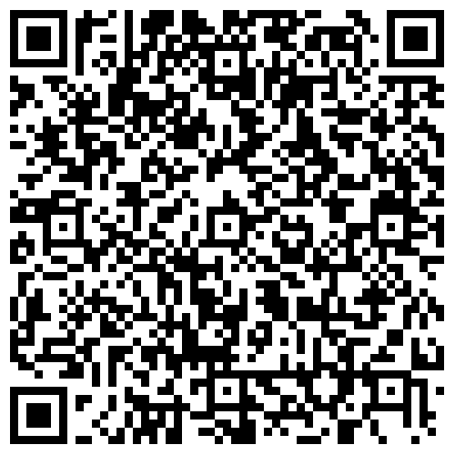
If you have never been a head coach before, you must scan the QR code below,
Complete it, and it will automatically be sent to me.
Background Check form

Slide 2
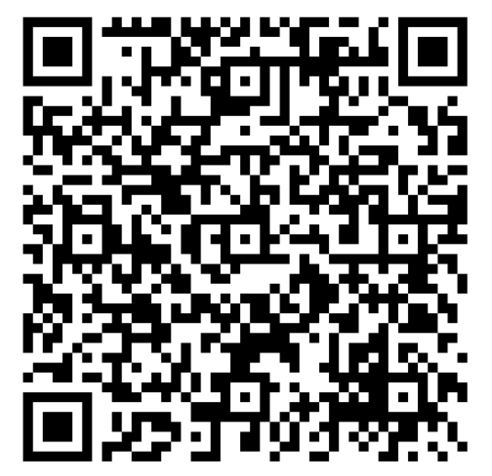
Please sign the form at the table or complete it, and email it to rshurtliff@fridaynightflag.com
Coach’s code of Conduct

Slide 3

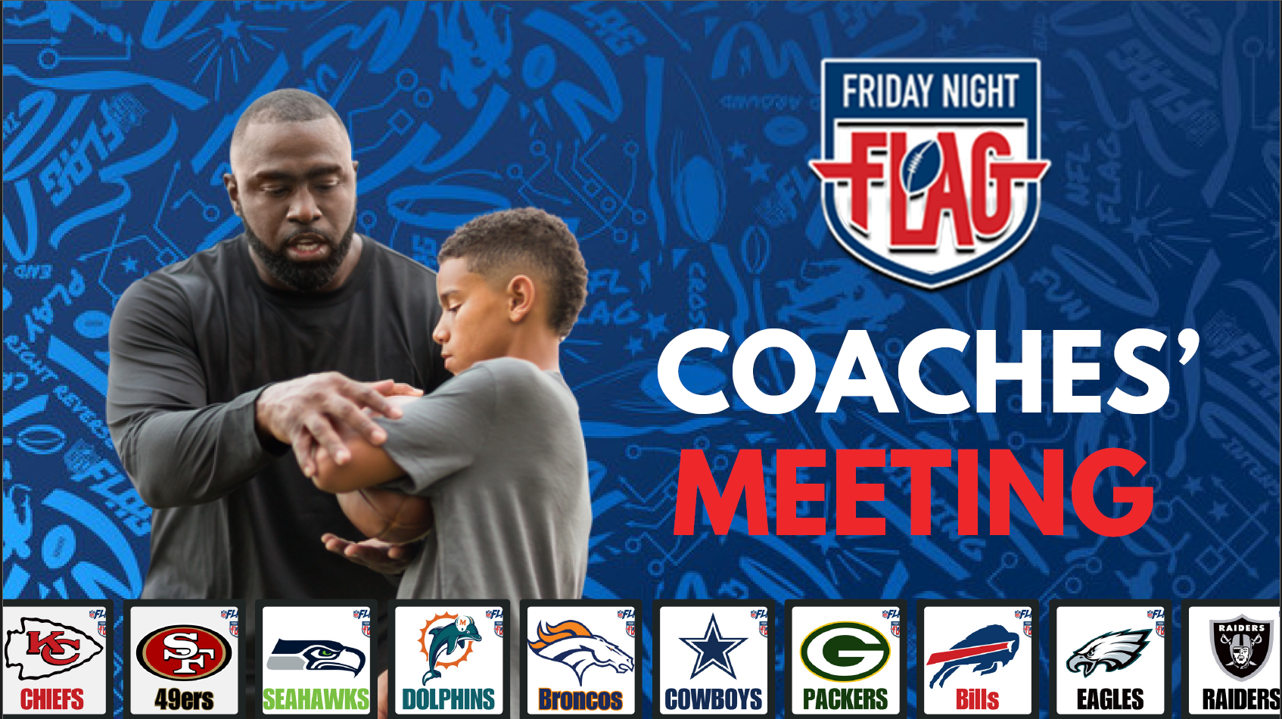

Slide 4

Introductions:

Slide 5

Coaches Meeting
Introductions
Reese Shurtliff- Owner and Operator of Idaho Falls League
  208-201-3801
  rshurtliff@fridaynightflag.com
If there is an issue during a game with officiating, feel free to send a parent over to me or Morgan Stewart or text me and we will come watch the game.

Slide 6

Coaches Meeting
Idaho Falls League
Games played Black Canyon Middle School
League Director: Reese Shurtliff
K – 8th Grade
10-12 Fields
4 Game Times:5:00 pm, 6:00 pm, 7:00 pm, 8:00 pm

Slide 7

Coaches Meeting
Welcome Coaches!
Please complete the following:
  Coaches code of conduct
  Sponsorship form (Now Online!)
  Background check form (e-sign)

Slide 8
Coaches Meeting Agenda
Announcements:
Code of Conduct
Coaching tools –MOJO app
League Basics
Rulebook Highlights

Slide 9
Coaches Meeting
Announcements:
We still have sponsorships available
Division Footballs:
K-2nd: Red Ball
3rd-4th: Blue Ball
5-8th: Brown Ball
Team Rosters – If you have room on your roster, you can still have kids sign up to be on your team.
Apparel – you can now order apparel online at
https://friday-night-flag.merchwebstore.com/

Slide 10
Coaches Meeting
Announcements:
Division Changes:
We have an all-girls division! 2nd-3rd 4th-5th and 6th-8th
League Updates:
Games may be on other days other than Friday
If you are in one of the larger divisions, and you are blowing teams out, you will be moved up for the playoffs. Do not be upset if you are moved up.
If you have kids on your team that are playing down, they will not be allowed to play and will not receive a refund.
New ring sponsorship available
Sponsorships can now be submitted online www.fridaynightflagsponsors.com
If you are a team sponsor, you can set up a booth at the field 1 time.
In the no-run zone you must do a forward pass, but you can do laterals and pitches before the forward pass.

Slide 11
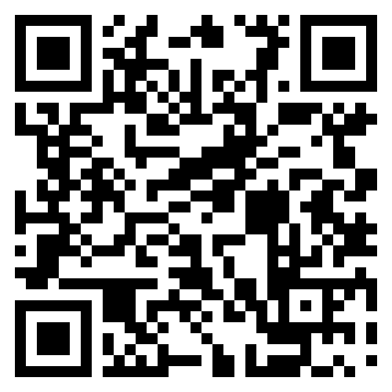
Coaches Meeting
Team Sponsors
$150 Team Sponsorship Required at time of Jersey pickup
We will send coaches an email template to send to parents to ask for sponsorships.
Sponsors get:
Logo on FNF Website for six months
Logo printed on banner that is displayed on the field
Ability to do booth or other promotion at field if interested (1 week)
E- sponsorship form

Slide 12

Coaches Meeting
Idaho Falls League Schedule
Game Nights
  Week 1: August 29th
  Week 2: September 5th
  Week 3: September 12th (Picture Day!)
  Week 4: September 19th
  Week 5: September 26th
  Week 6: October 3rd(PLAYOFFS)
  Week 7: October 10th(CHAMPIONSHIPS)
Game Times: 5:00, 6:00, 7:00, 8:00

Slide 13

Coaches Meeting
Jersey Pickup:
Wednesday, Aug 13th 5:00pm-7:00pm
Dicks Sporting Goods
Idaho Falls, ID
TEAM Sponsorship Required at time of pick up $150
Link to sponsorship form:
Sponsorship Form
Sponsors get-
Logo on FNF Website for six months
Logo printed on banner that is displayed on the field
Ability to do booth or other promotion at field (1 time)

Slide 14

Coaches Meeting
Referees – We are looking for Older high school and Adult referees
Contact
Please contact me or Morgan with any refereeing issues so we can correct them.
Please remember most of these referees are young kids who need to be treated with respect from coaches and fans. If you do not show them respect you will receive a warning.
One referee will have the rulebook downloaded to his/her phone. You can call a time out, challenge the call (if they have mistaken a rule) and if you are right, you will keep timeout. This will not work with judgement calls.

Slide 15

Coaches Meeting
Code of Conduct
Review and practice the Friday Night Flag Rules.
Organize practices that are fun and challenging.
Place the well being of players ahead of desire to win.
Treat each player as an individual; emotional / physical development may be different for each child.
Lead by example, demonstrate fair play and sportsmanship.
Do not harass referees or other team members.
Provide each child with equal play time during practice and games.
Refrain from cussing, yelling or using negative language at practice and games.
Provide a safe playing situation for players free of drugs and alcohol.
Make sure all players are picked up after practice and games.
You are a youth sports coach, this game is for the children, not adults.
Encourage parents to read and obey the code of conduct.

Slide 16

Coaches Meeting
Coaching Code of Conduct
Love that people want to win and love that it is a big deal but we have to make sure we don’t take it too far.
Every year we lose referees because coaches and parents yell at them
Creates a cycle where we have less experienced referees who are more prone to getting yelled at
Our referees better paid and trained then any other flag football league but we need to retain them!
Having a conversation with a referee different then berating referee (only Head Coach should be talking to referee. If head coach is gone then one assistant can talk to referee).
If having problems have a parent get Reese to watch game
NEW PROCESS to ensure we are following code of conduct
1st instance- Email warning or on-field warning from Reese
2nd instance- 1 game suspension
3rd instance- Suspended for rest of season

Slide 17
Coaches Meeting
2025 Changes to Rulebook
No rushing /blitzing in Kinder
Interceptions on PAT are returnable for 2 points
No rushing/blitzing when team is up 30 points or more
Only one point conversions allowed when up by 30 points
Only Friday Night Flag Jerseys and shorts are allowed.
Jerseys need to be tucked into the shorts
¾ coaches are not allowed on the field (during the play anymore)
4th downs
Offensive Jumping is allowed unless the player is diving or jumping into another player
Fumbles – if a snap hits ground, can play it. (some exceptions)

Slide 18

Coaches Meeting
Coaching Tools – Coaches’ Corner on Website
Play books and rulebook on FNF website “Coaches’ Corner”
Tips and Drills on Website
  Coaches Corner
  NFL Flag Playbook
Mojo coaching partnered with NFL Flag
  Videos of all the NFL flag plays
  Tailors your team age and skill level to help you make practice.

Slide 19
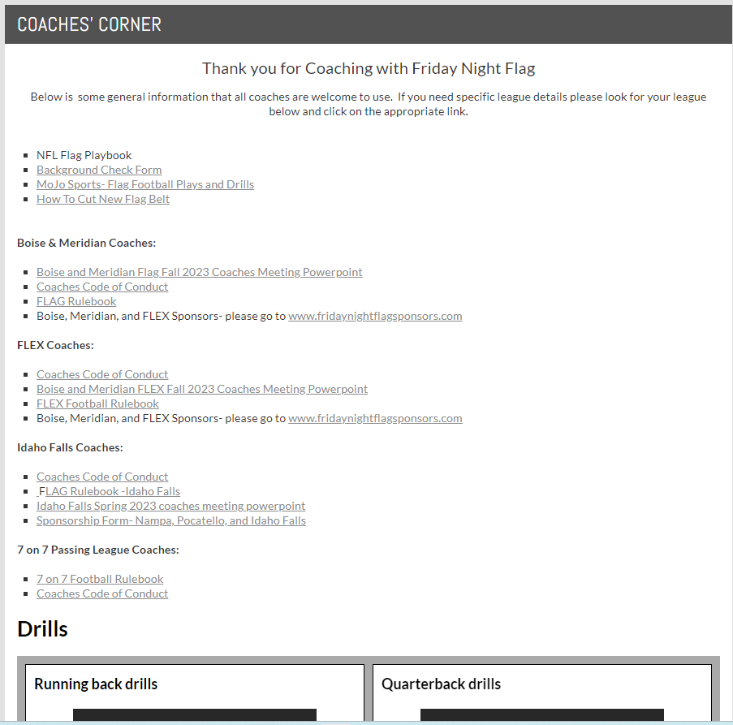
Coaches Meeting
Website

Slide 20
Veteran coaches may leave if they want

Slide 21

Coaches Meeting
League Basics: PRACTICES
Practices begin this week
One practice per week, four practices before season starts
1.5 hours or less –
Find convenient location for parents
  Local park or school; first come basis
Coordinate day/time with parents
Scrimmages
  One scrimmage is allowed before the first game. This scrimmage is optional and can be held in addition to a regular weekly practice.
  Coaches schedule their own scrimmages. We also use scrimmages to train officials

Slide 22

Coaches Meeting
League Basics: GAMES
5 vs. 5
10 min. quarters, subs at quarter and mid-quarter
Offense starts at 5-yard line
Two No-Run Zones
  Passing in no-run zone
  Penalties in no-run zone
3 Plays to Mid-Field, with the option to play the 4th down, 3 Plays to Score
Coaches on field During the play
  K, 1-2: Allowed on field entire season
  3-8: no coaches on field

Slide 23
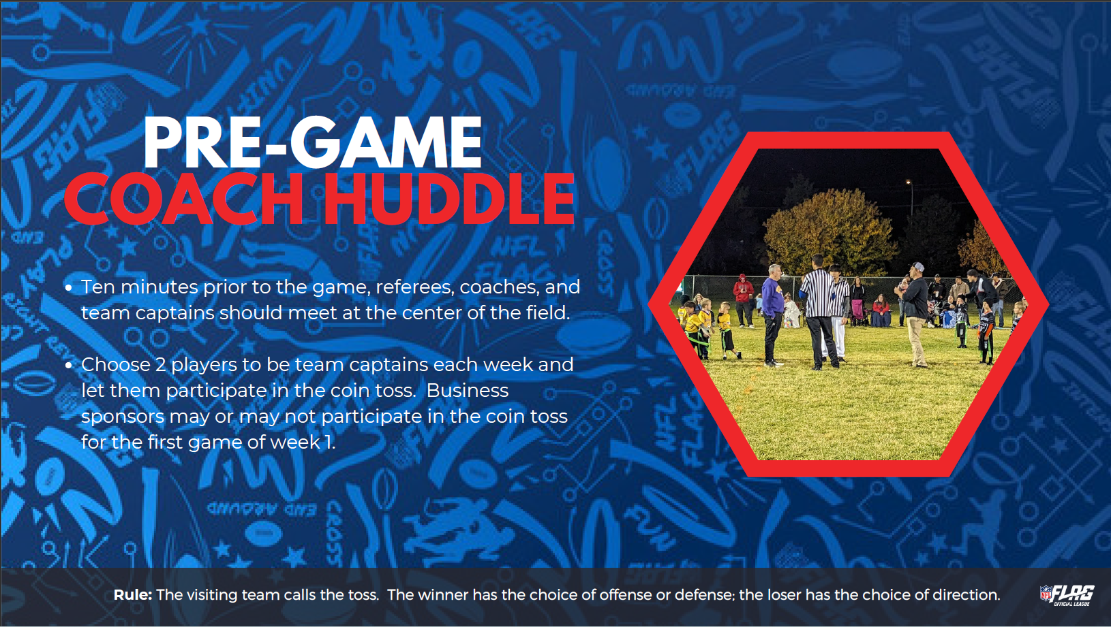
Veteran coaches may leave if they want

Slide 24

Coaches Meeting
League Basics: EQUIPMENT
Jerseys (NFL Flag only, supplied by league)
Flags (NFL supplied flags only, supplied by league)
Black shorts or pants, no stripes
  One pair of Friday Night Flag shorts supplied by league
Mouth guards optional this season (Recommended)
Cleats, not required but encouraged
No belt loops on pants/shorts
Wristbands for plays (optional, not supplied by league)
Team Sponsorships REQUIRED to receive jerseys, must have sponsorship form/payment at Jersey Pickup

Slide 25

Coaches Meeting
Rulebook Highlights
Black shorts or pants
Scoring: front foot, not the ball location
Quarterback: 7 seconds to throw, not a penalty, loss of down only
Equal playing time
Injured players, substitutions
  Playoff Seeding
    Standings
    Win – Loss
    Points Against
    Also look at opponents
Game-day practice Park
  No more than ½ hr before your game to “warm up”
Practices
    Only 1 per week.
    No more than 1.5 hours long

Slide 26

Coaches Meeting
Coaching Tools- Coaches’ Corner on Website
Play books
https://nflflag.com/coaches/default/flag-football-rules/5-on-5-flag-football-playbook
NFLFLAG.com Plays and Drills
Tips and Drills on Website
MOJO App
Friday night Flag Rulebook:fnf rulebook
Flagfootballplaymaker.com

